Slide 1
Developer Student Clubs Train the Trainer
Neural Networks
Akshay Bahadur
SDE at Symantec
YouTube Live (September 27, 2019)
Notes:
If you have read anything about machine learning you may have come across the term "Neural Network". They are a popular choice for machine learning models because of their ability to handle complex data and make accurate predictions where simpler models might fall short.

Slide 2



Akshay Bahadur
SDE – Symantec
Intel Software Innovator
Google Developer Expert
(Machine Learning)

Slide 3
Agenda
Basics of Neural Networks
Perception of a Neuron
Modelling a Neuron
Activation Function
Common Activation Functions
Optimizing the Neural Networks
Random Initialization
Normalization
Network Architecture optimization
Optimization Algorithms
Problem of Overfitting
DeepSign

Slide 4

Notes:
Questions after the video:
What is your definition of a neural network?
What can a Neural Network do?
What questions do you have?
What was interesting or surprising?
Video Source: Google, How machines learn (9:00)

Slide 5

Tania’s Story

Slide 6

ACTIVATED NEURONS
INPUT LAYER
OUTPUT LAYER
Image adapted from becominghuman.ai by Venkatesh Tata
Notes:
What is a neural network?
In short it’s a mathematical function that maps a given input to a desired output.
In the Introductory module, you learned about a couple types of machine learning models such as classification, regression, etc. Simple models work fine work simple data but as soon as you want to interpret complex data like an image, audio, or even numerical data with lots of variables e.g. for housing prices = location + number of bedrooms + size + etc you need something capable of dealing with that complexity.
These simpler models are connected into layers and this is where the depth of "deep" learning comes from.
In reality a neural network is a big complex mathematical function which looks nothing like what you see here but the diagram may help you see what's going on.
Like any other machine learning system, a model is trained with data fed into the model and it attempts to make a prediction. At first the prediction will be essentially garbage but that feedback is used to improve the model.
Once the prediction quality is sufficient, the model is tested with new data and it makes a prediction based on what it learned from the training data.
What this diagram doesn't show is how each neuron is able to learn and improve based on feedback. Let's look more deeply at how a neuron is able to make a decision.
Image adapted from becominghuman.ai by Venkatesh Tata

Slide 7
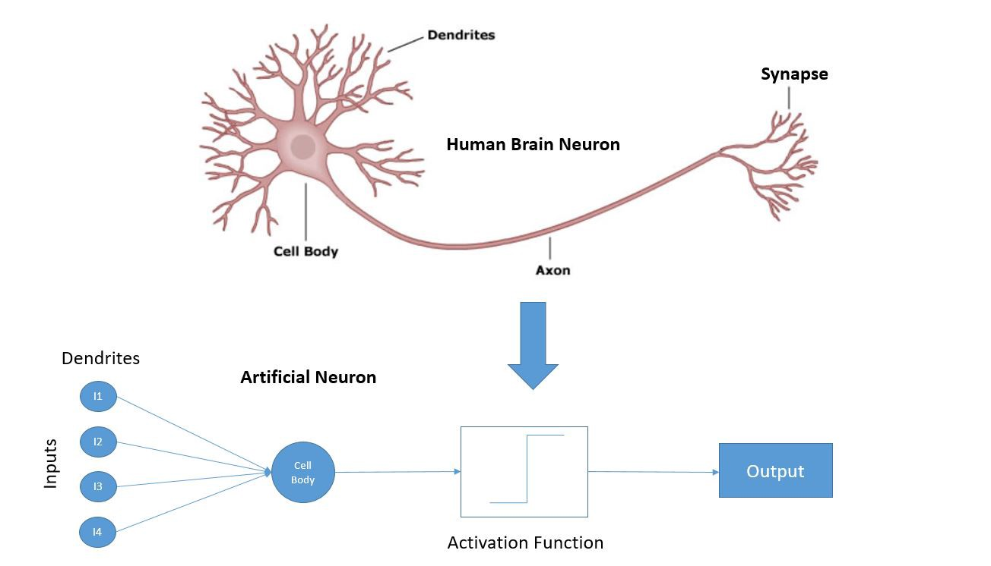
Brain cells v/s Neural Network
akshaybahadur.com
Notes:
Similarity of ANN with Human Brain.

Slide 8
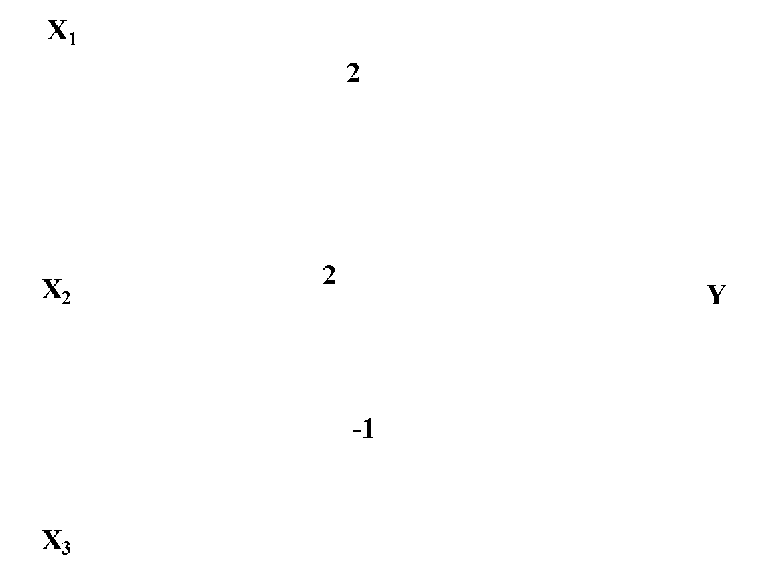
Basics of Neural Network
X₁
2
X₂
2
Y
-1
X₃
akshaybahadur.com
Notes:
Similarity of ANN with Human Brain.

Slide 9
Basics of Neural Network
The activation of a neuron is binary. That is, the neuron either fires (activation of one) or does not fire (activation of zero).
For the network shown the activation function for unit Y is
f(y_in) = 1, if y_in >= θ else 0
Where y_in is the total input signal received
θ is the threshold for Y
Each neuron has a fixed threshold. If the net input into the neuron is greater than the threshold, the neuron fires
akshaybahadur.com

Slide 10
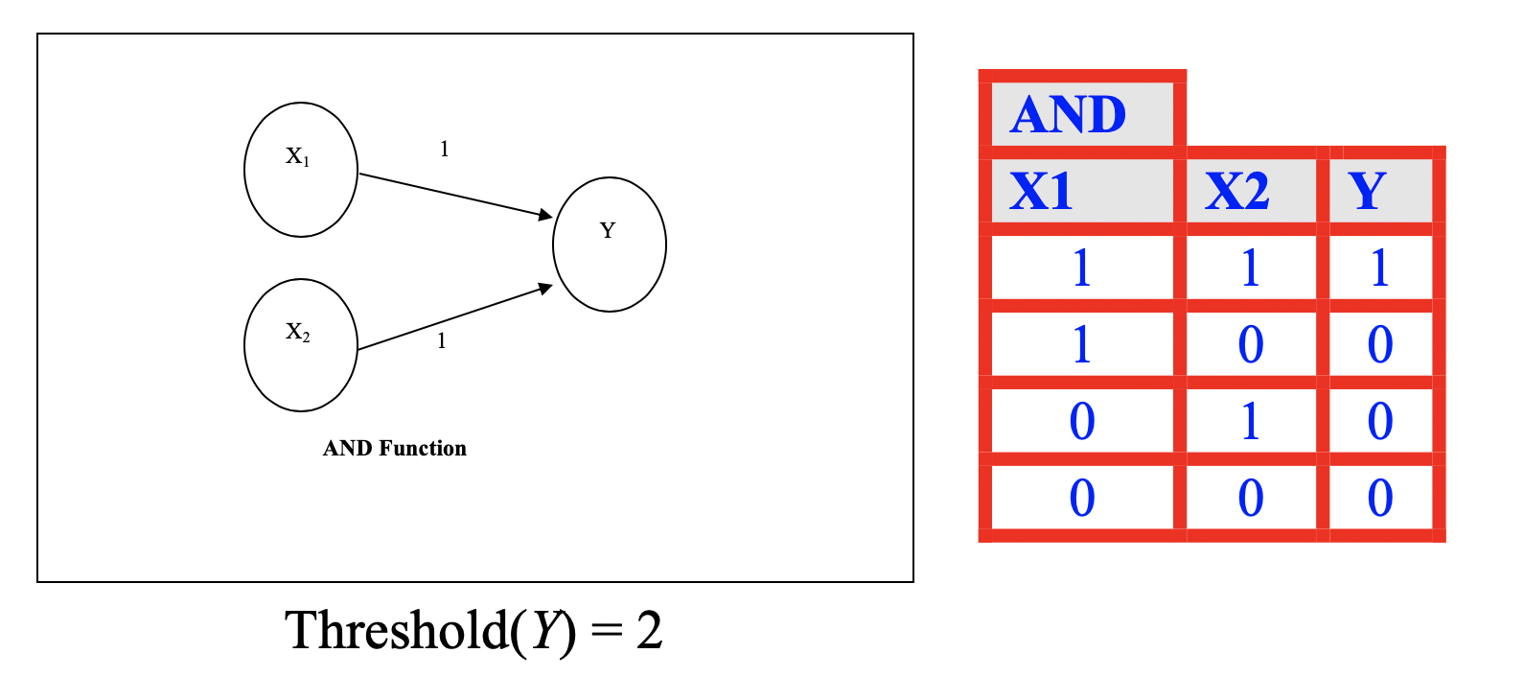
Basics of Neural Network
akshaybahadur.com

Slide 11
Perception of Artificial Neuron
Activate Neuron
Input
Activation Function
Yes
No
Do not activate neuron
akshaybahadur.com
Notes:
Apply an activation function to a neuron. This is the mathematical way of setting the threshold or condition for activating a neuron
This is similar to if...then statements in programming e.g., If time > 11am eat lunch.
The neuron checks to see if the input value meets the activation function's requirements
If it does not, then do nothing and pass no value onto any connected neurons in the network
If it does, do something to the data and pass the result as an input to next neuron.
This operation is carried out across all of the nodes in the network allowing very complex patterns to be learned and predictions to be made
Let's look at a couple of examples

Slide 12
Perception of Artificial Neuron
Activate Neuron
5
< 10
Yes
Do not activate neuron
akshaybahadur.com
Notes:
The number 5 is the input to this neuron.
The neuron's activation function has learned to check if a number is < 10.
This input passes the test and so the neuron is activated.
This is one of the simplest forms of a neural network. It's effectively the same as linear regression or fitting a line to data.

Slide 13
Perception of Artificial Neuron
Activate Neuron
Has a curve?
No
Do not activate neuron
akshaybahadur.com
Notes:
The input to this neuron is an image of the number 7
The neuron's activation function has learned to check if an image like this has a curve
This input does not so it fails to pass the test and so the neuron is not activated.

Slide 14
Perception of Artificial Neuron
Activate Neuron
Has a curve?
Yes
Do not activate neuron
akshaybahadur.com
Notes:
However, the input to this neuron is an image of the number 6
This input does have a curve so it passes the test, the neuron is not activated, and the information is passed to the next neuron.
Simple functions like these can combine to make more complex decisions. For example, the ability of this neuron to determine whether or not the input has a curve is due to other neurons checking to see for example if a pixel is black or not.
[Pause and ask for questions or anything that needs clarification]

Slide 15
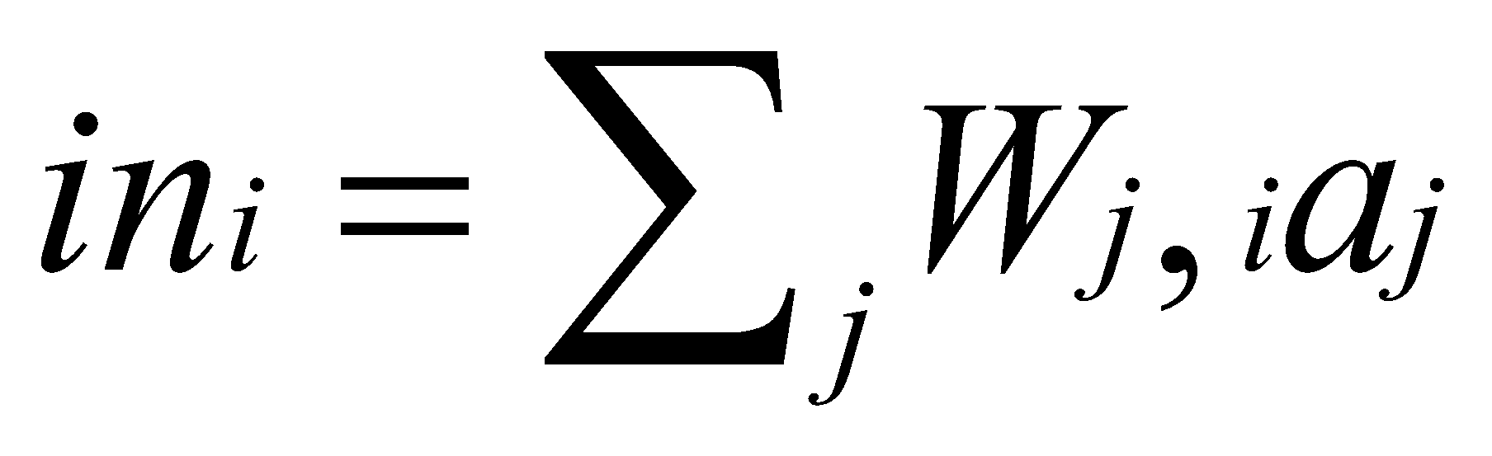
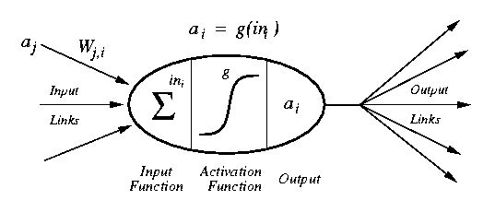
Modelling a Neuron
a_{j} :Activation value of unit j
w_{j,I} :Weight on the link from unit j to unit i
in_{I} :Weighted sum of inputs to unit i
a_{I} :Activation value of unit i
g :Activation function
akshaybahadur.com

Slide 16
Activation Functions
Activation function decides, whether a neuron should be activated or not by calculating weighted sum and further adding bias with it. The purpose of the activation function is to introduce non-linearity into the output of a neuron.
A neural network without an activation function is essentially just a linear regression model. The activation function does the non-linear transformation to the input making it capable to learn and perform more complex tasks.
If we removed the activation function from our algorithm that can be called linear activation function.
akshaybahadur.com

Slide 17
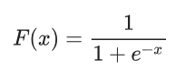
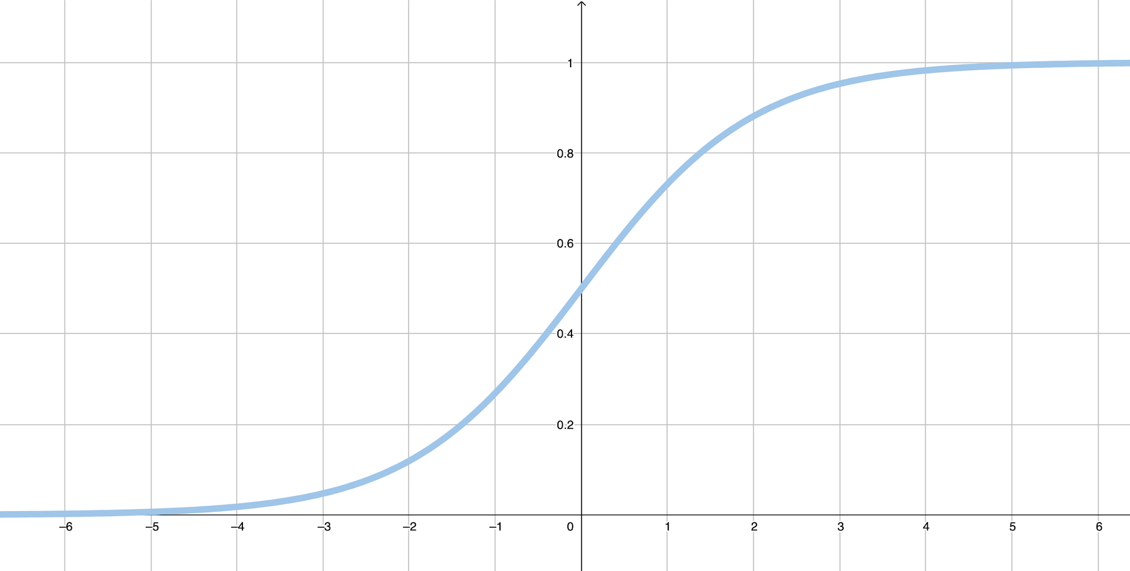
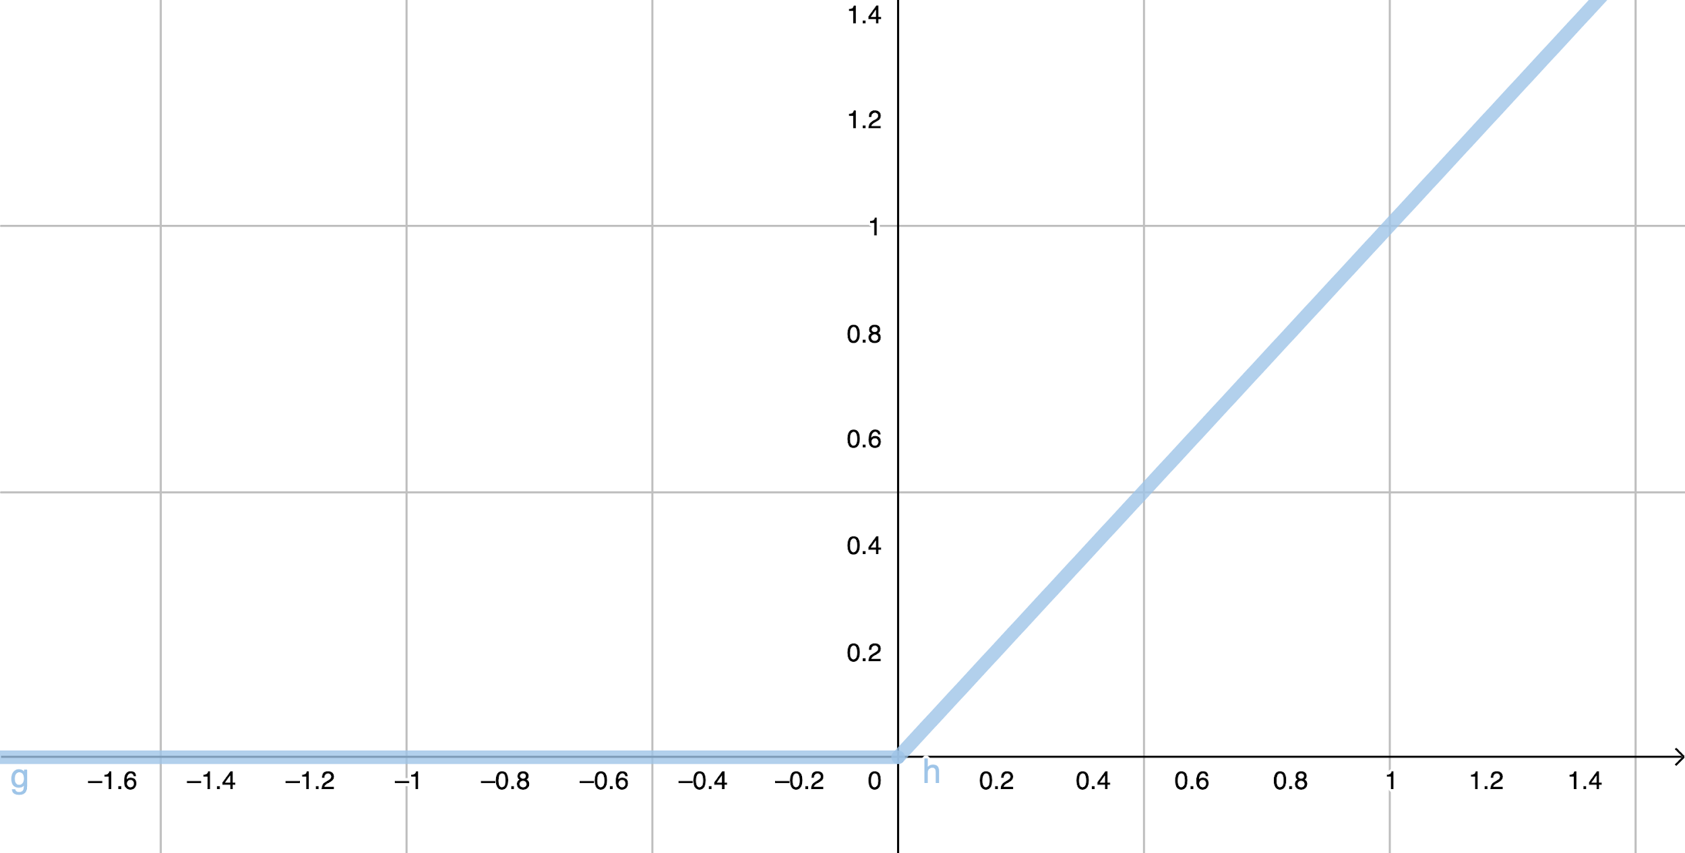
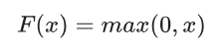
Common Activation Functions
Sigmoid activation function converts the weighted sum to a value between 0 and 1.
ReLU (Rectified Linear Unit) activation function often works a little better than a smooth function like the sigmoid, while also being significantly easier to compute.
akshaybahadur.com
Notes:
Researchers describe the field of machine learning less like engineering and more like scientific exploration. For example, for a long time the sigmoid activation function was used until the ReLU function was discovered to be more efficient and effective for many situations.
It's not necessary to know all of the mathematics behind machine learning in order to use it but it's shown here to reinforce the concept that machine learning is at its core a complex mathematical function that is trained to do well on a particular goal.
It turns out that the tanh activation usually works better than sigmoid activation function for hidden units because the mean of its output is closer to zero, and so it centers the data better for the next layer.
Sigmoid or Tanh function disadvantage is that if the input is too small or too high, the slope will be near zero which will cause us the gradient decent problem.

Slide 18
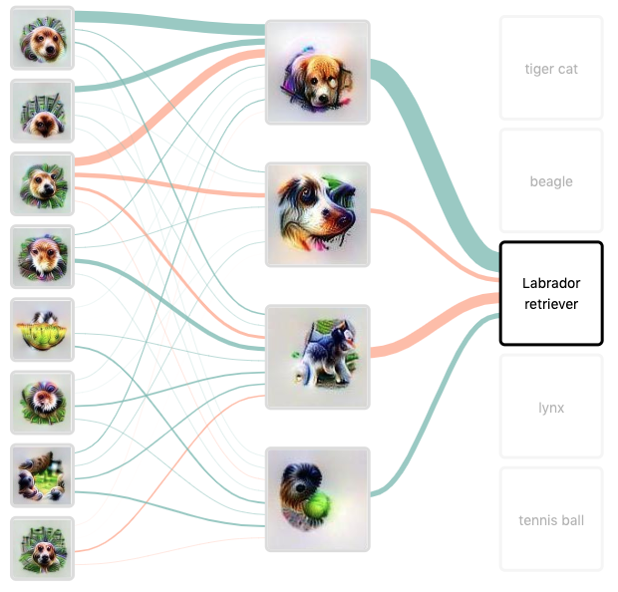

Image adapted from Distill.pub article by Chris Olah et al.
Notes:
A neural network can be comprised of many hidden layers. These are intermediate steps to get from the prediction to the output. For example a neural network may have layers to detect certain colors, and shapes and other layers to differentiate between certain types of animals and breeds.
It's important to clarify, the neural network does not know what a dog or cat is, it's just learning to do what we want it to do based on feedback and the patterns it detects.
But how does a neural network learn from feedback? Neural networks were loosely modeled after the biological brain. The connections between neurons can be strengthened and weakened using weights and biases. For example, when a dog receives a treat and a pat on the head for retrieving a ball, it is more likely to do that again.
Weights and biases allow a neural network to learn what pathways "work" for a certain task and bias the network to use those pathways again. This makes the network more effective and efficient at making predictions.
All of these complex calculations are accomplished far more quickly and often than a human could ever hope to do. It requires a lot of computing power to achieve high quality results which is why Neural Networks were once thought infeasible but now data centers (also known as computing clouds) with greater computer processing power make neural networks a reality.
Image adapted from Distill Pub - Building Blocks of Interpretability

Slide 19
Optimizing the Neural Networks

Slide 20

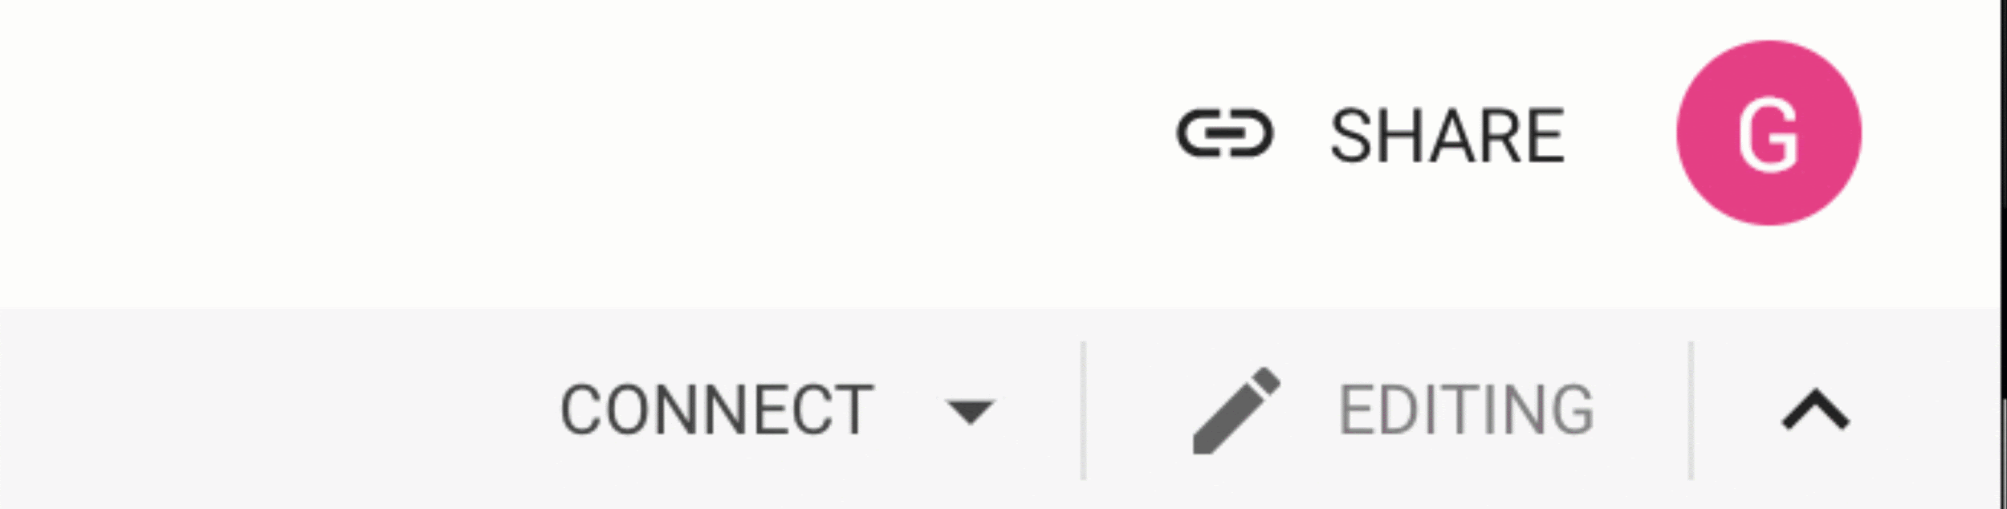
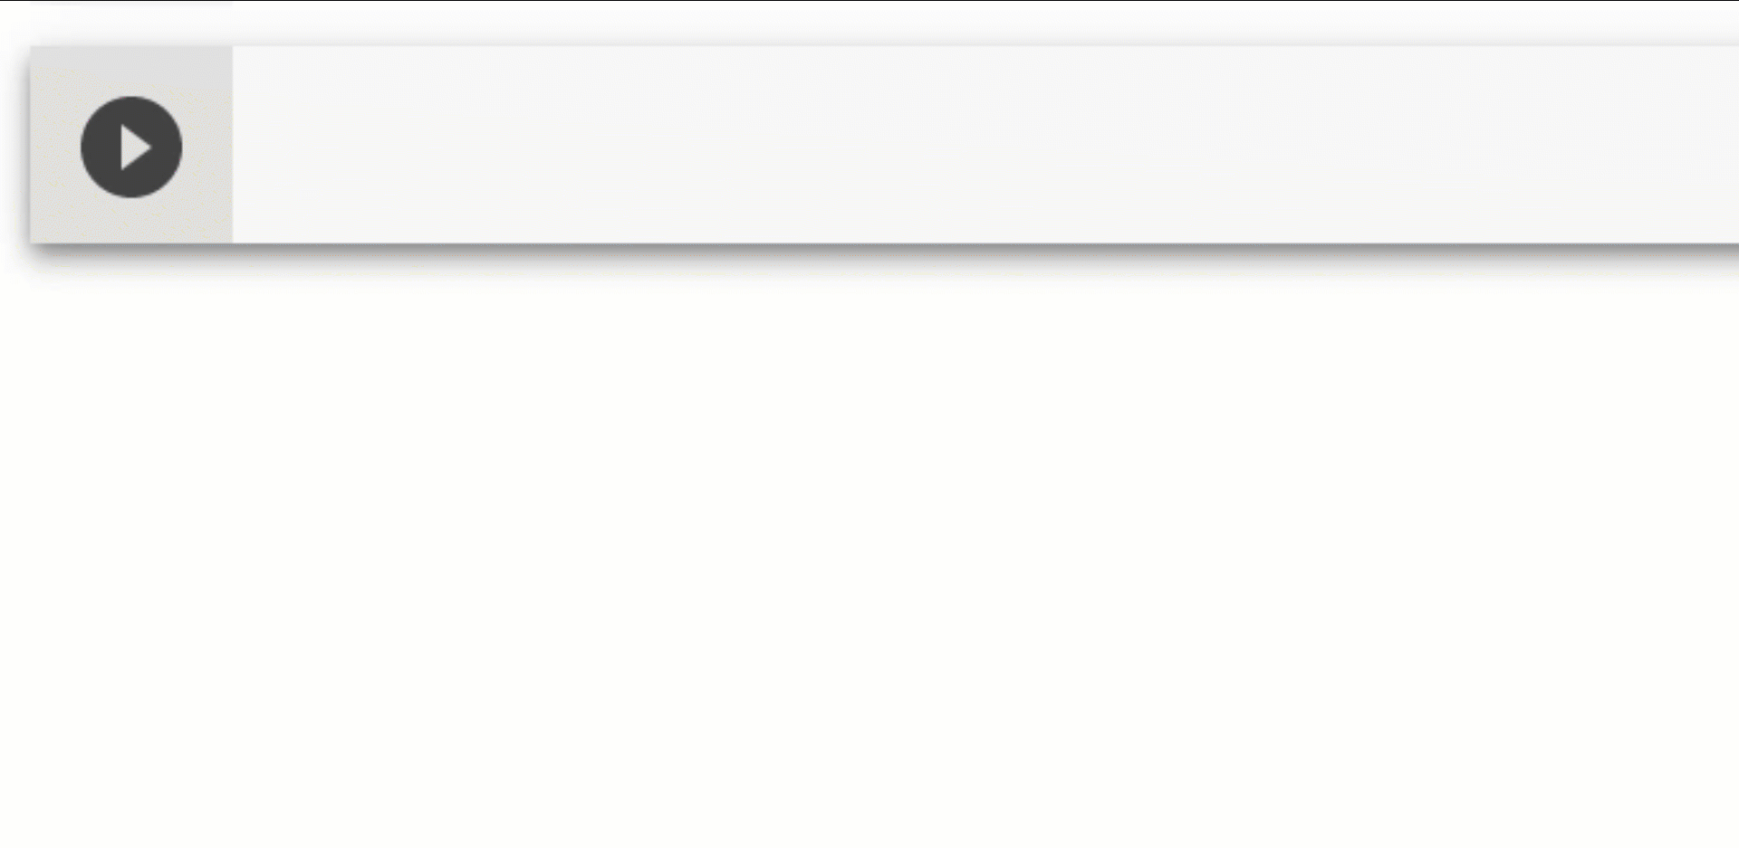
MNIST
http://bit.ly/dsc-ttt
Open the exercise in Colab
Sign in with your Google account
Activate the Runtime
Run code
akshaybahadur.com

Slide 21
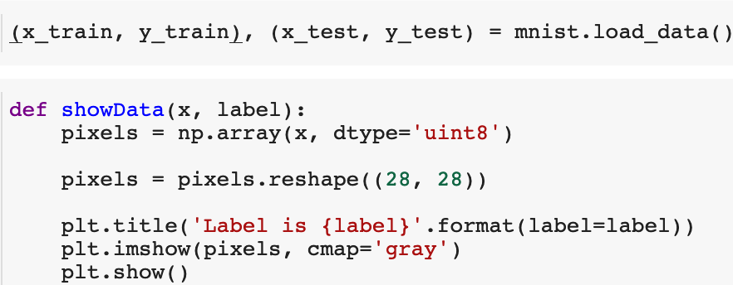
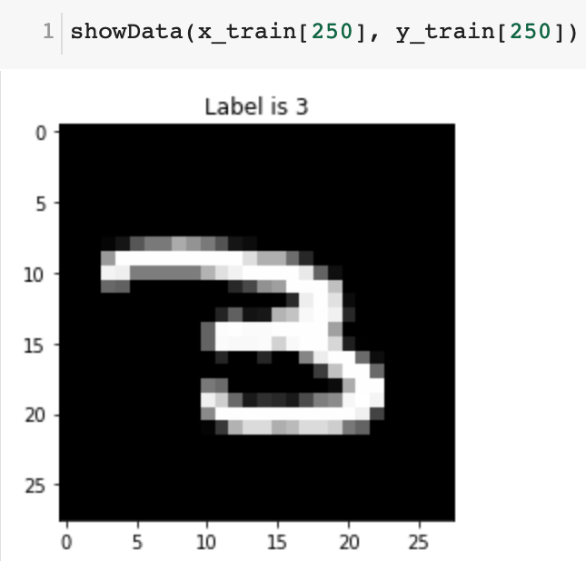
MNIST
akshaybahadur.com

Slide 22
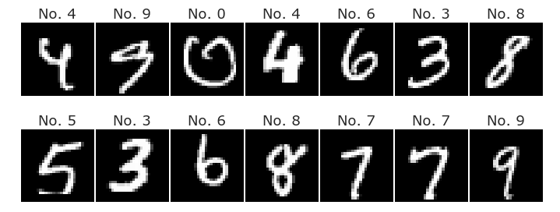
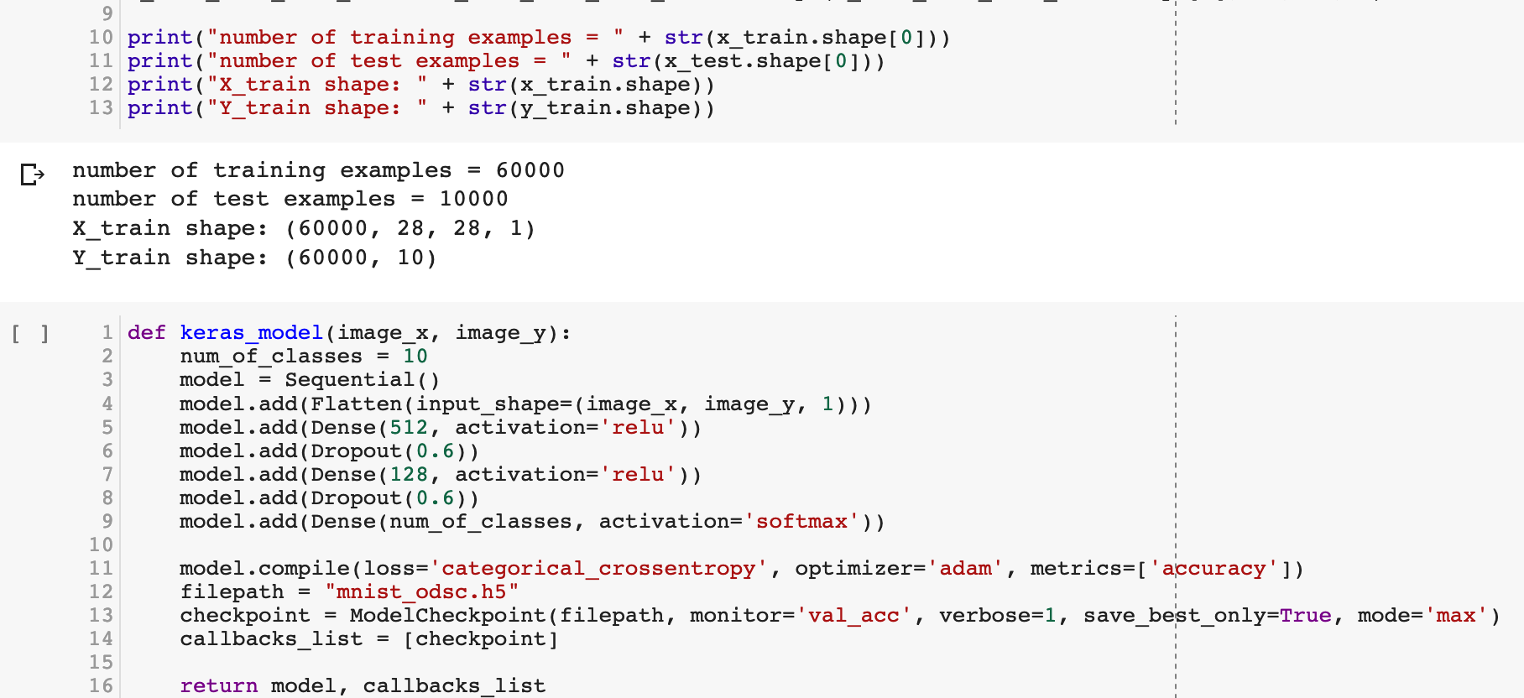
MNIST
akshaybahadur.com

Slide 23
MNIST
Setup the Layers
model = keras.Sequential([
keras.layers.Flatten(input_shape=(28, 28)),
keras.layers.Dense(512, activation=tf.nn.relu), kernel_initializer=initializer),
keras.layers.Dropout(0.6)
keras.layers.Dense(128, activation=tf.nn.relu),
keras.layers.Dropout(0.6)
keras.layers.Dense(10, activation=tf.nn.softmax)
])
akshaybahadur.com

Slide 24
MNIST
Compile the model
model.compile(optimizer='adam',
loss='categorical_crossentropy',
metrics=['accuracy'])
akshaybahadur.com

Slide 25
Random Initialization
Zero Initialization - If we set all the weights to be zero, then all the the neurons of all the layers performs the same calculation, giving the same output and there by making the whole deep net useless.
Random Initialization - In this method, the weights are initialized very close to zero, but randomly. This helps in breaking symmetry and every neuron is no longer performing the same computation.
He-et-al Initialization - In this method, the weights are initialized keeping in mind the size of the previous layer which helps in attaining a global minimum of the cost function faster and more efficiently.
akshaybahadur.com

Slide 26
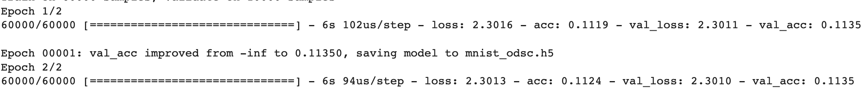
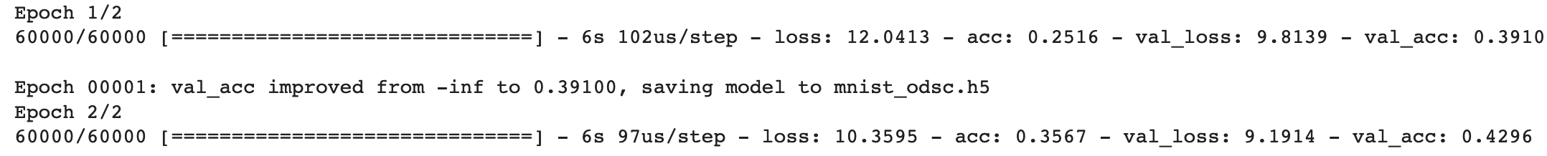
Random Initialization
initializer=keras.initializers.Zeros()
initializer= keras.initializers.RandomNormal(mean=0.0, stddev=0.05, seed=None)
akshaybahadur.com
Notes:
Researchers describe the field of machine learning less like engineering and more like scientific exploration. For example, for a long time the sigmoid activation function was used until the ReLU function was discovered to be more efficient and effective for many situations.
It's not necessary to know all of the mathematics behind machine learning in order to use it but it's shown here to reinforce the concept that machine learning is at its core a complex mathematical function that is trained to do well on a particular goal.
It turns out that the tanh activation usually works better than sigmoid activation function for hidden units because the mean of its output is closer to zero, and so it centers the data better for the next layer.
Sigmoid or Tanh function disadvantage is that if the input is too small or too high, the slope will be near zero which will cause us the gradient decent problem.

Slide 27
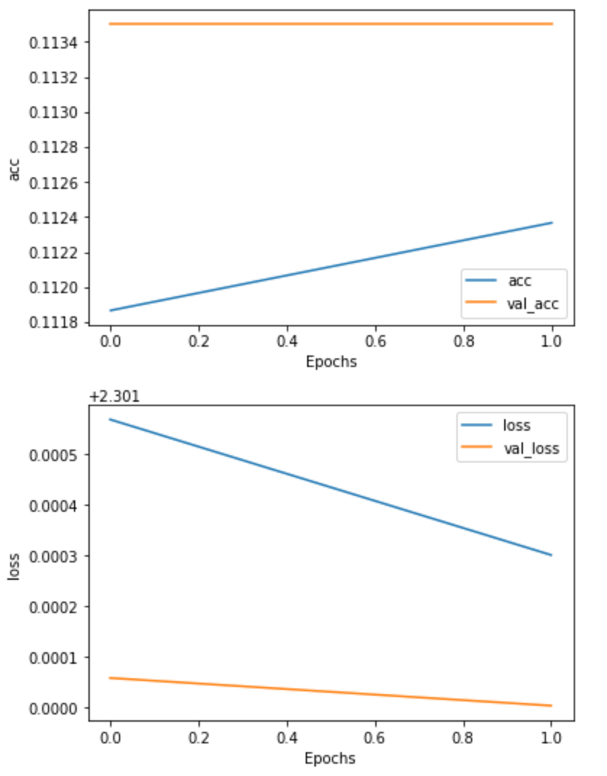
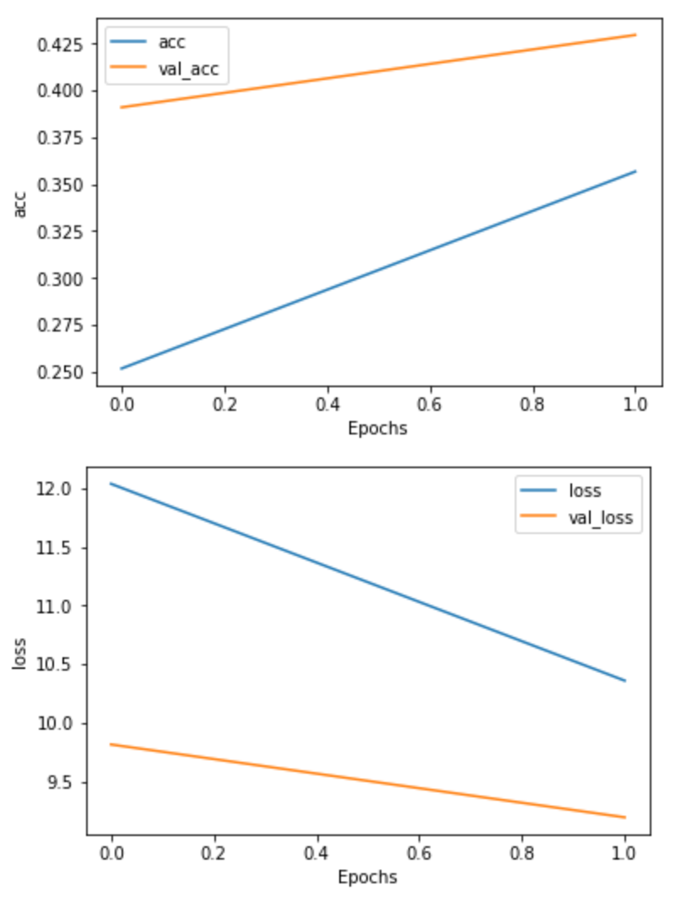
akshaybahadur.com

Slide 28
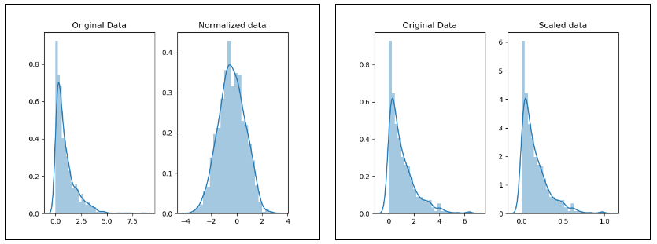
Normalization and Scaling
Scaling deals with changing the range of values from one scale to another, eg -3000 - 5000 to 100 - 200.
Normalization is the process of transforming a set of values so that they follow a normal distribution. This is often done because many parametric models like neural networks assume that your data is drawn from a normal distribution.

Slide 29
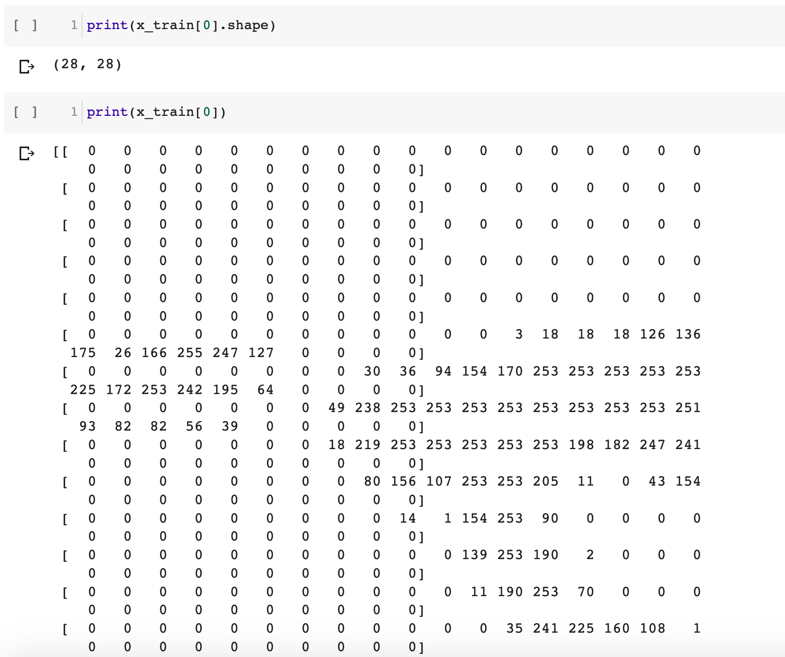
akshaybahadur.com

Slide 30
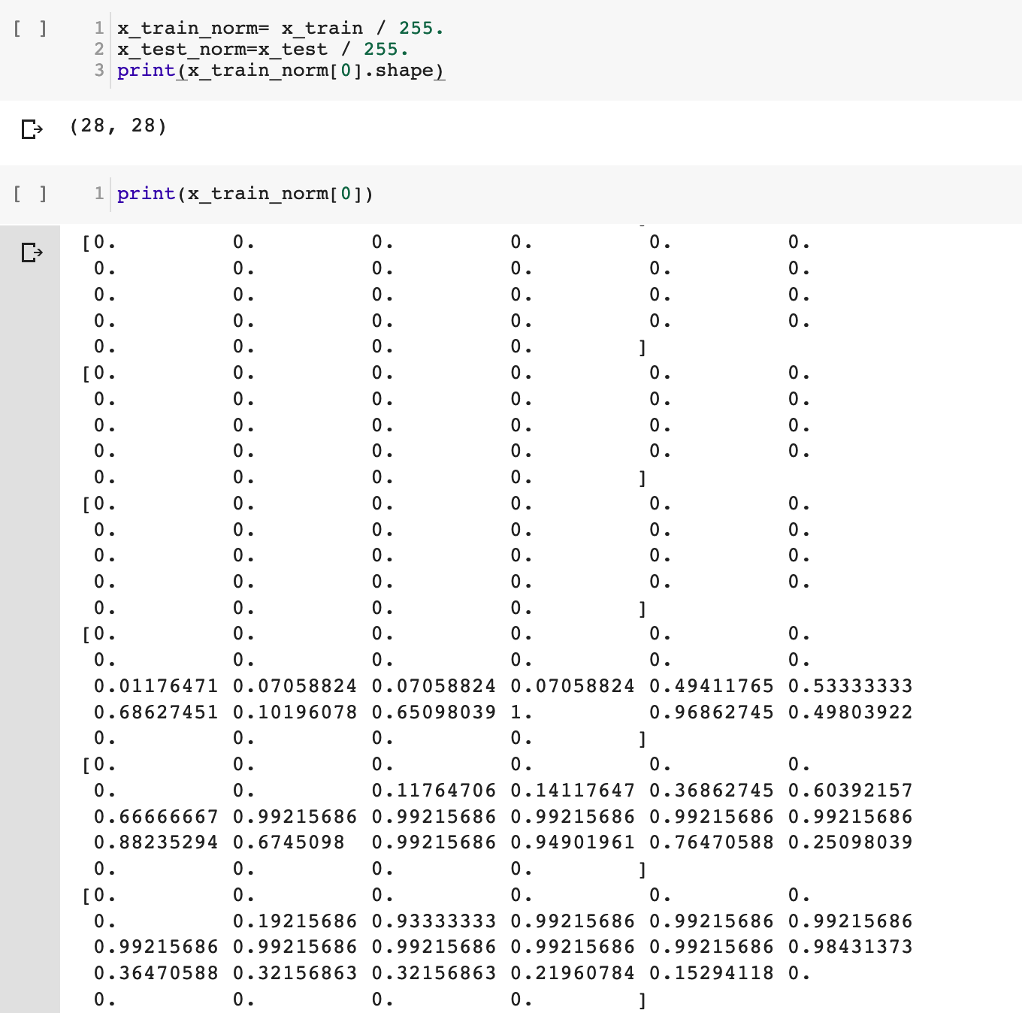
akshaybahadur.com

Slide 31
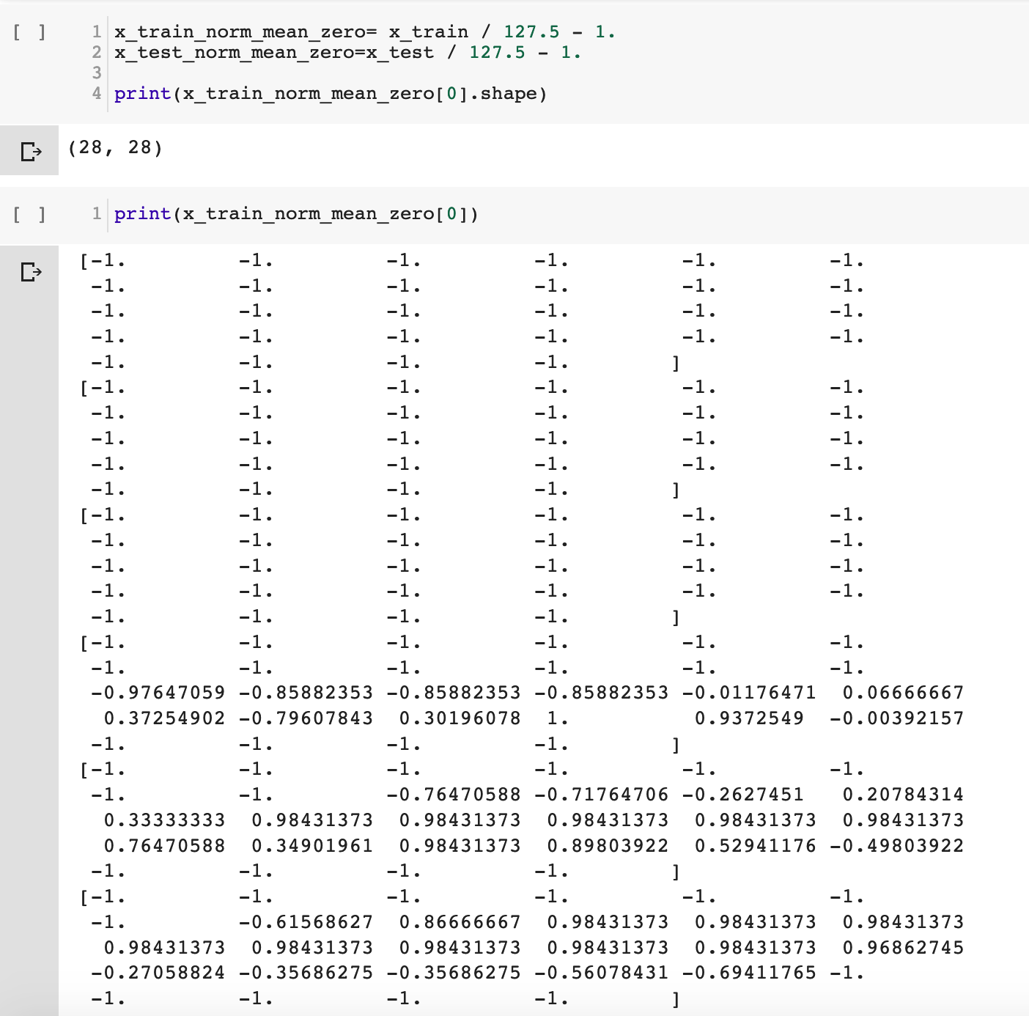
akshaybahadur.com

Slide 32
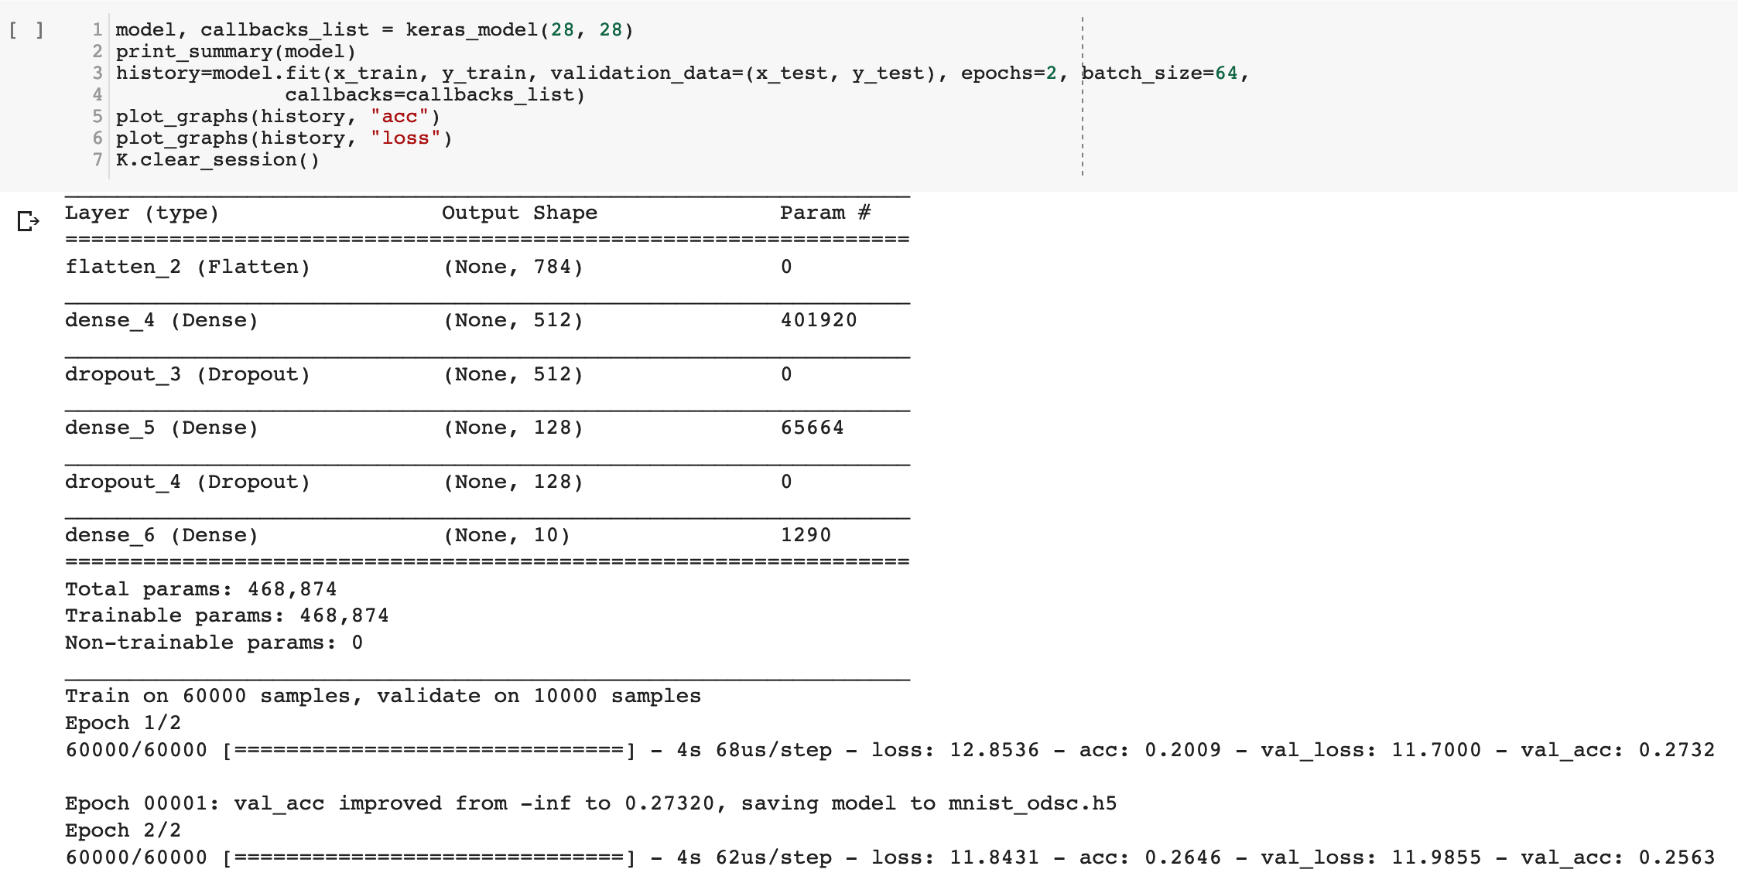
MNIST
Train the Model
history = model.fit(train_images, train_labels, epochs=2)
akshaybahadur.com

Slide 33
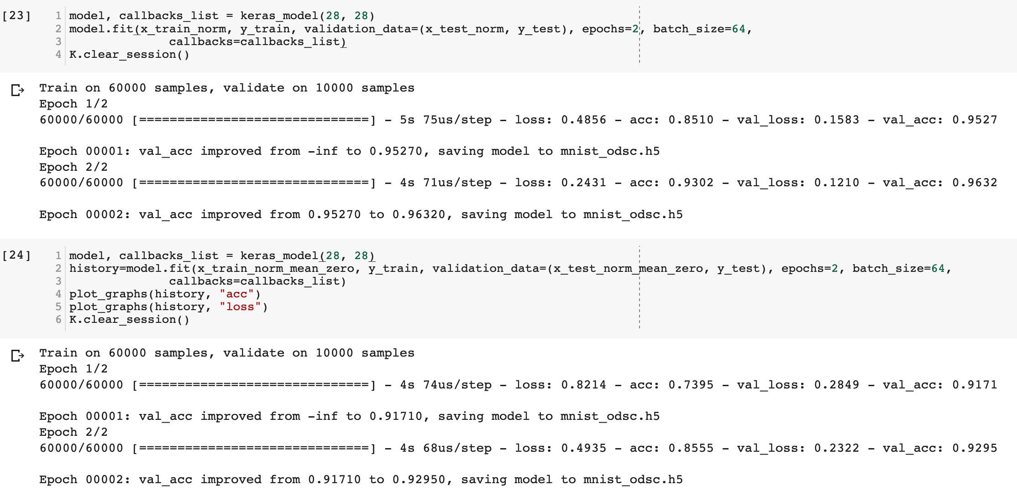
akshaybahadur.com

Slide 34
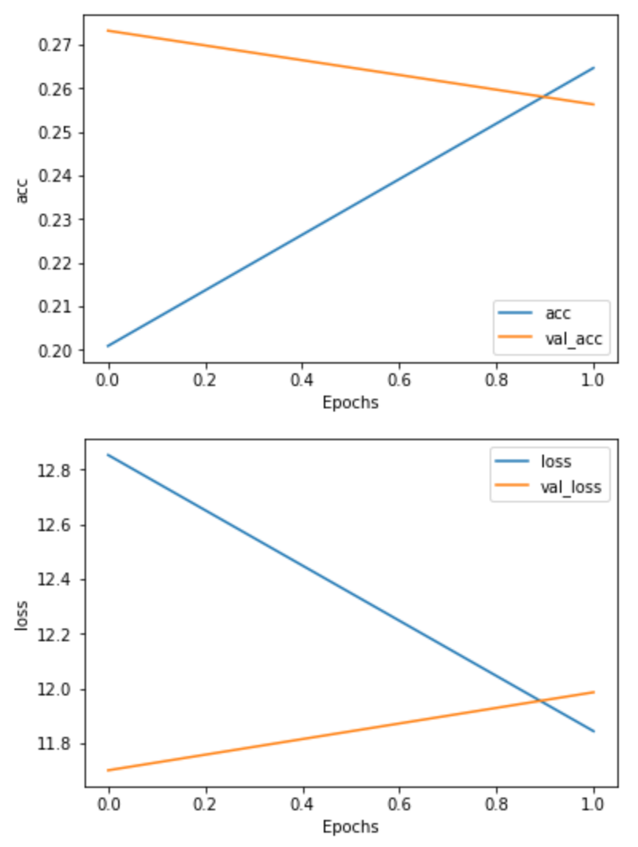
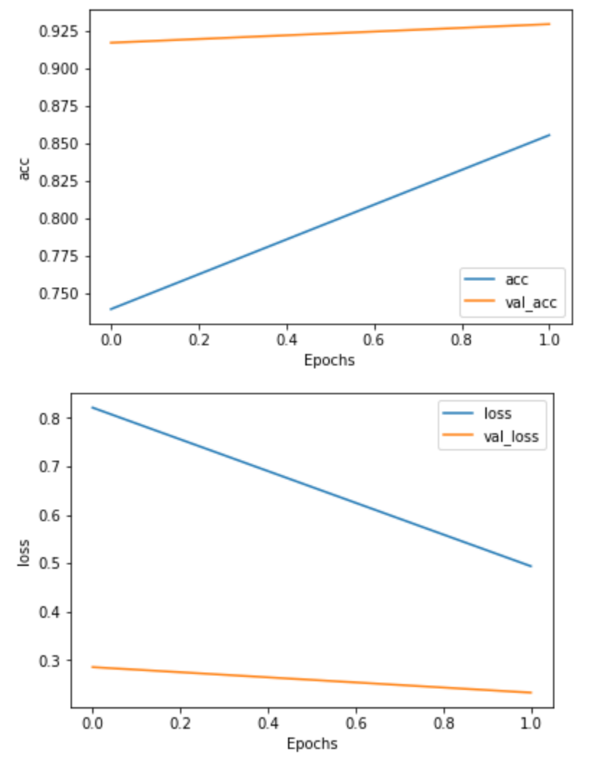
akshaybahadur.com

Slide 35
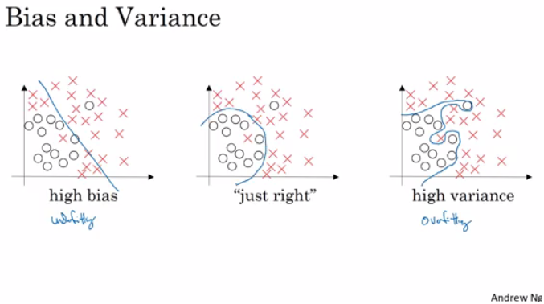
Bias/Variance Tradeoff
Bias - If your model is underfitting it has a "high bias”
Variance - If your model is overfitting then it has a "high variance”
akshaybahadur.com

Slide 36
Best Recipe for Bias/ Variance
High Bias
Increase Neural Net size (size of hidden units, number of layers)
Different Network Architecture.
Train for longer
Advanced optimization algorithms
High Variance
More data
Regularization
Different model
akshaybahadur.com

Slide 37
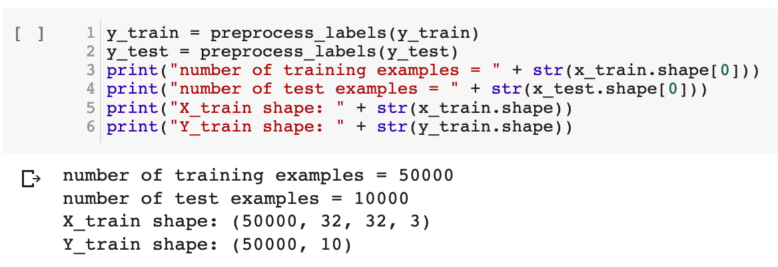
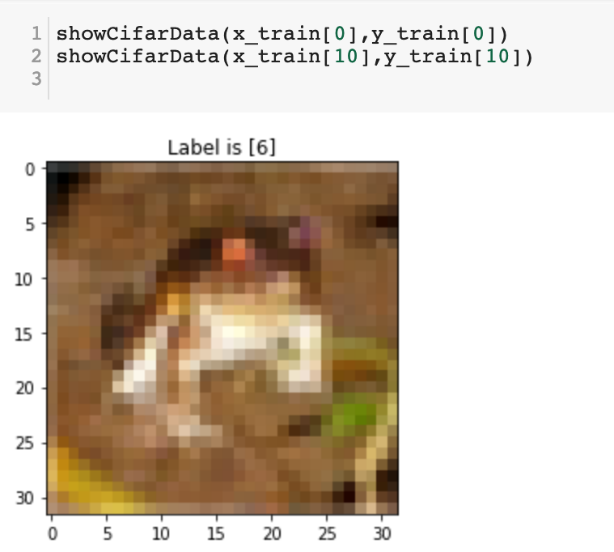
Network Architecture Optimization
Cifar 10

Slide 38
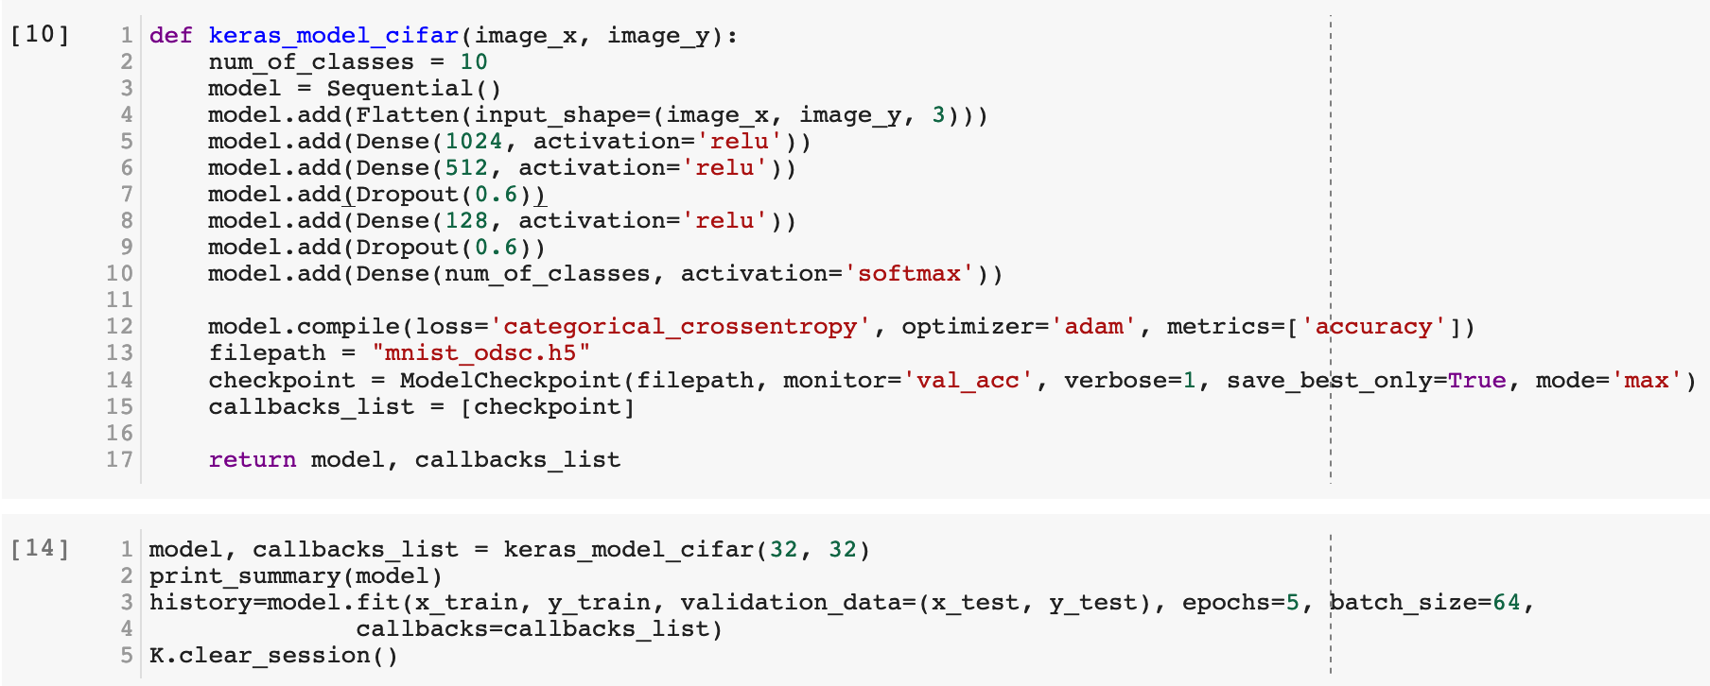
FC Architecture
akshaybahadur.com
Notes:
RMSprop

Slide 39
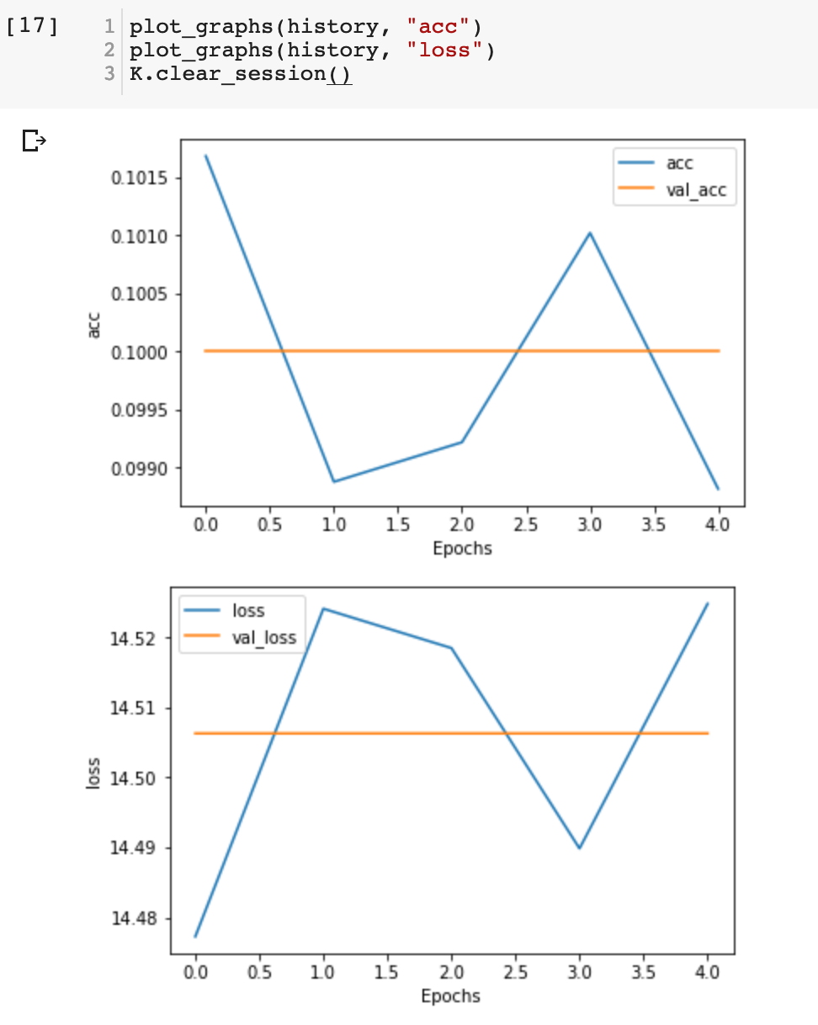
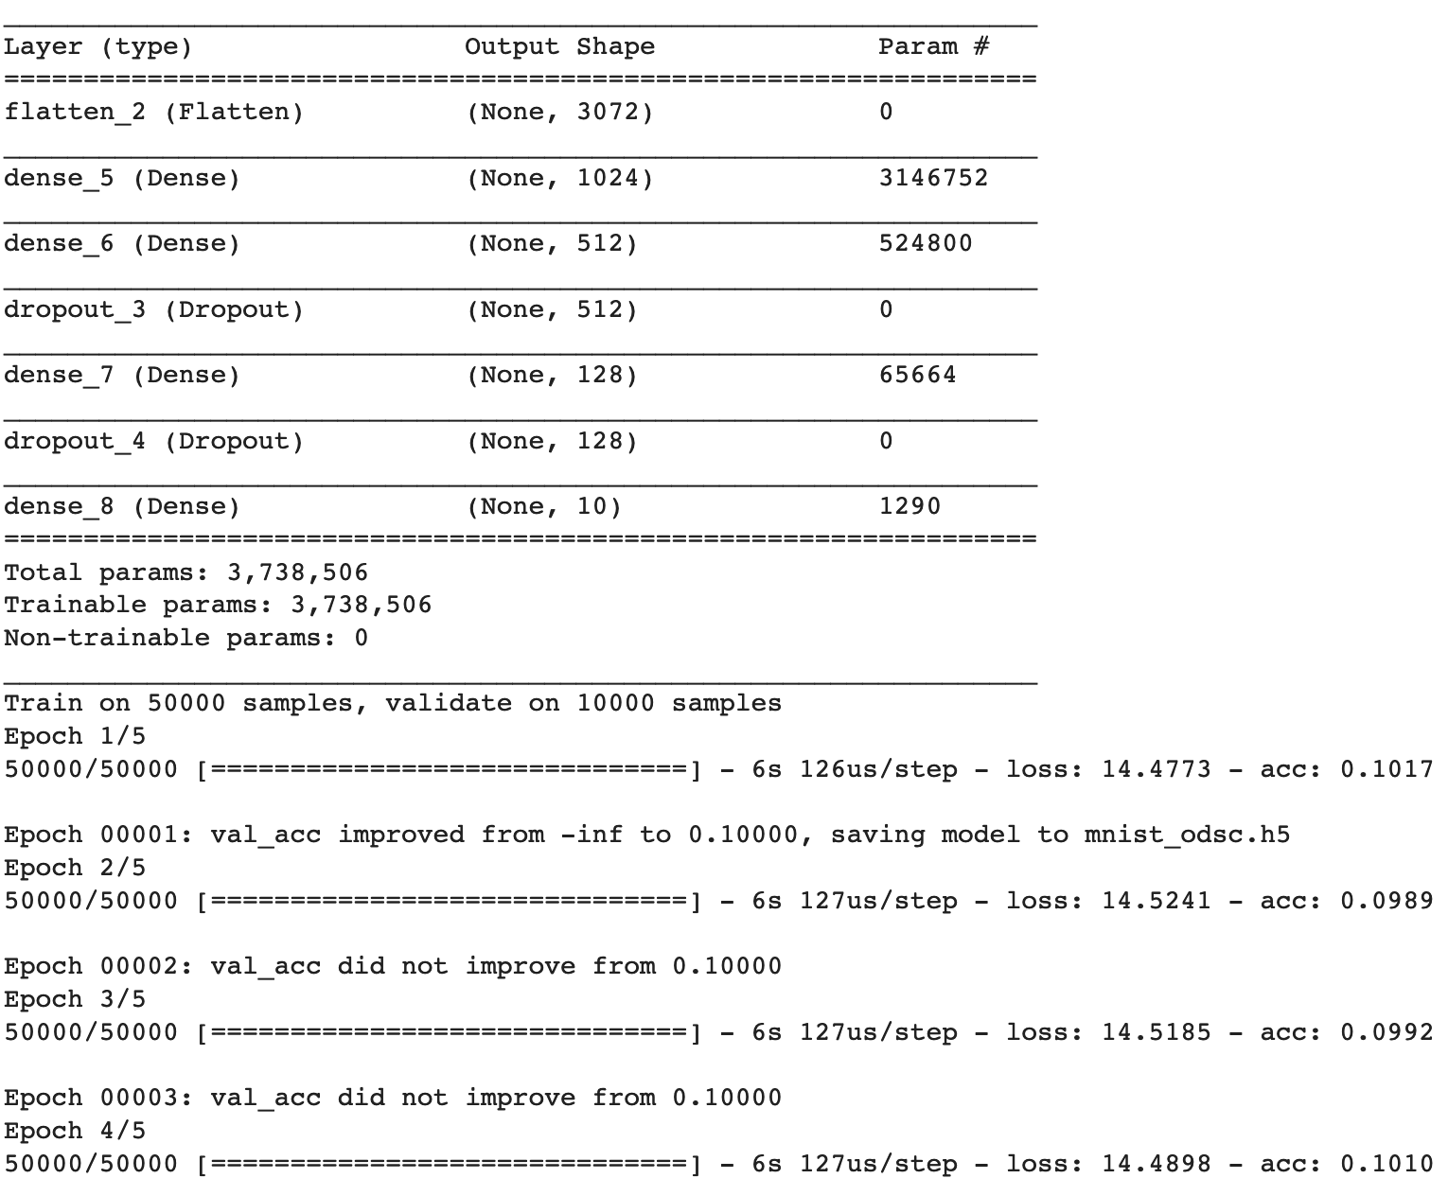

Slide 40
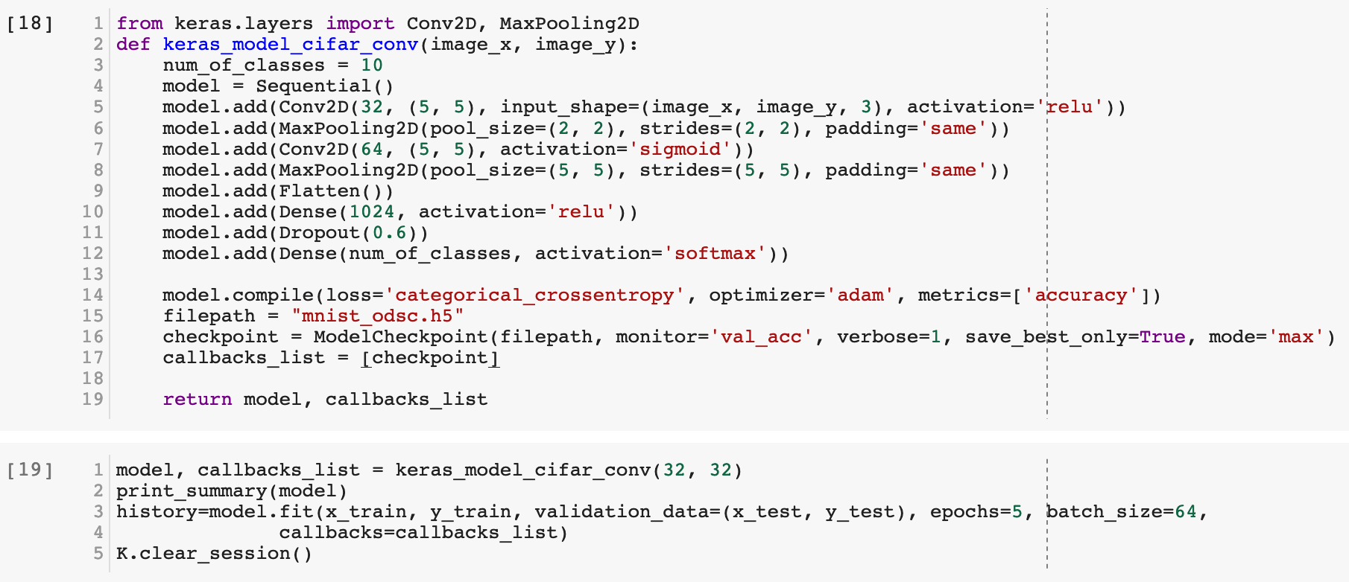
CNN Architecture
akshaybahadur.com
Notes:
RMSprop

Slide 41
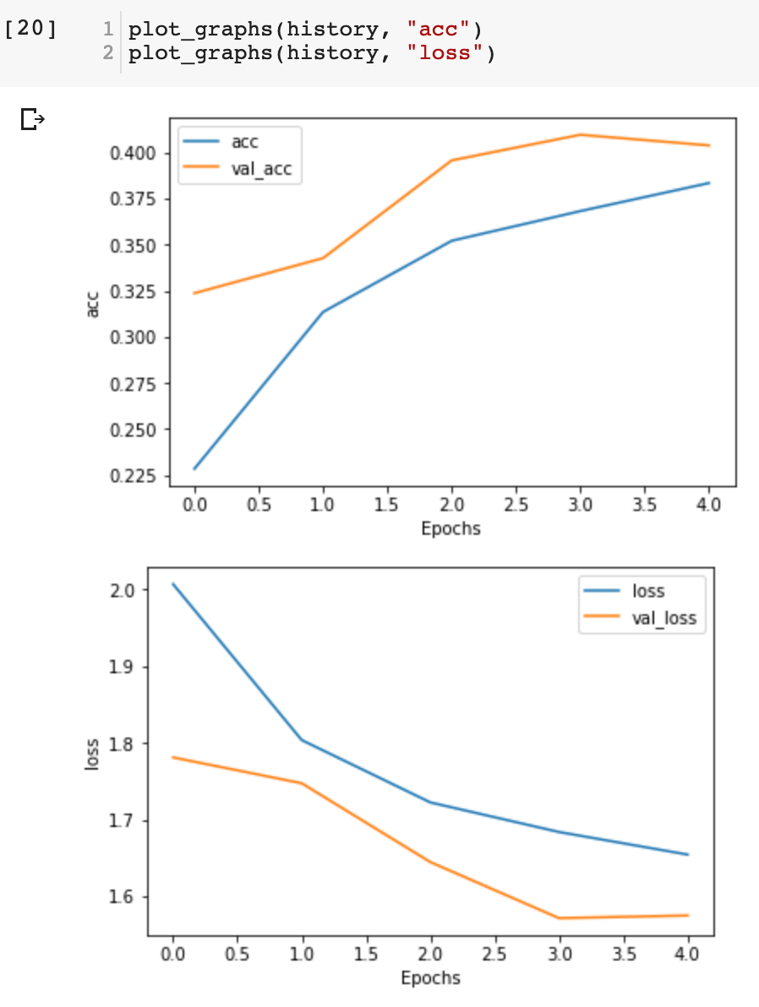
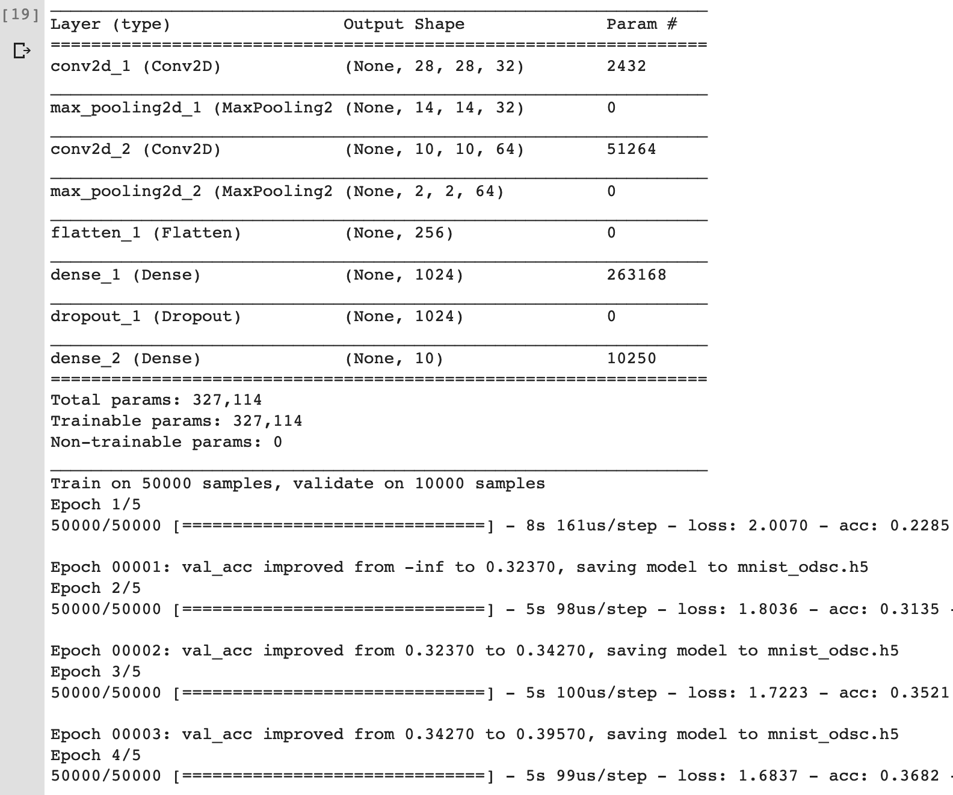

Slide 42
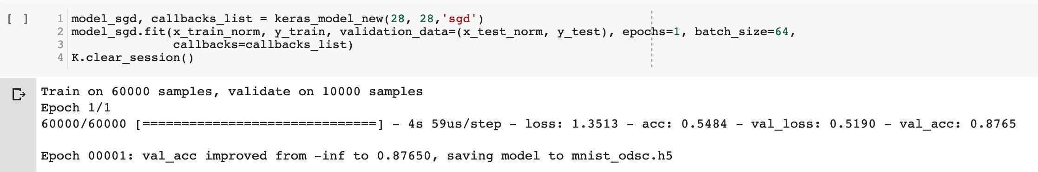
Optimization Algorithms
Gradient Descent
Batch gradient descent
Mini-batch gradient descent
Stochastic gradient descent (SGD)
akshaybahadur.com

Slide 43
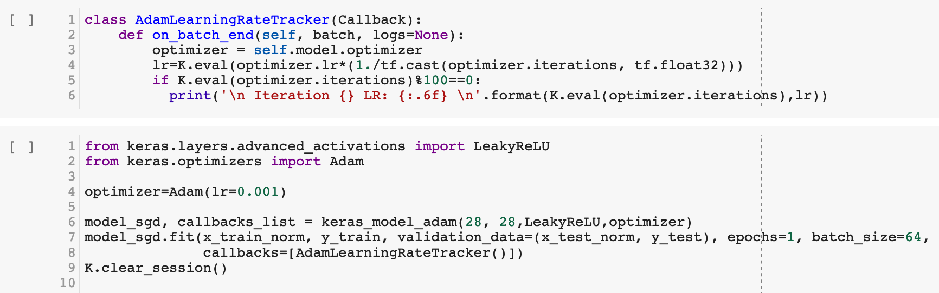
Learning Rate Decay
akshaybahadur.com

Slide 44
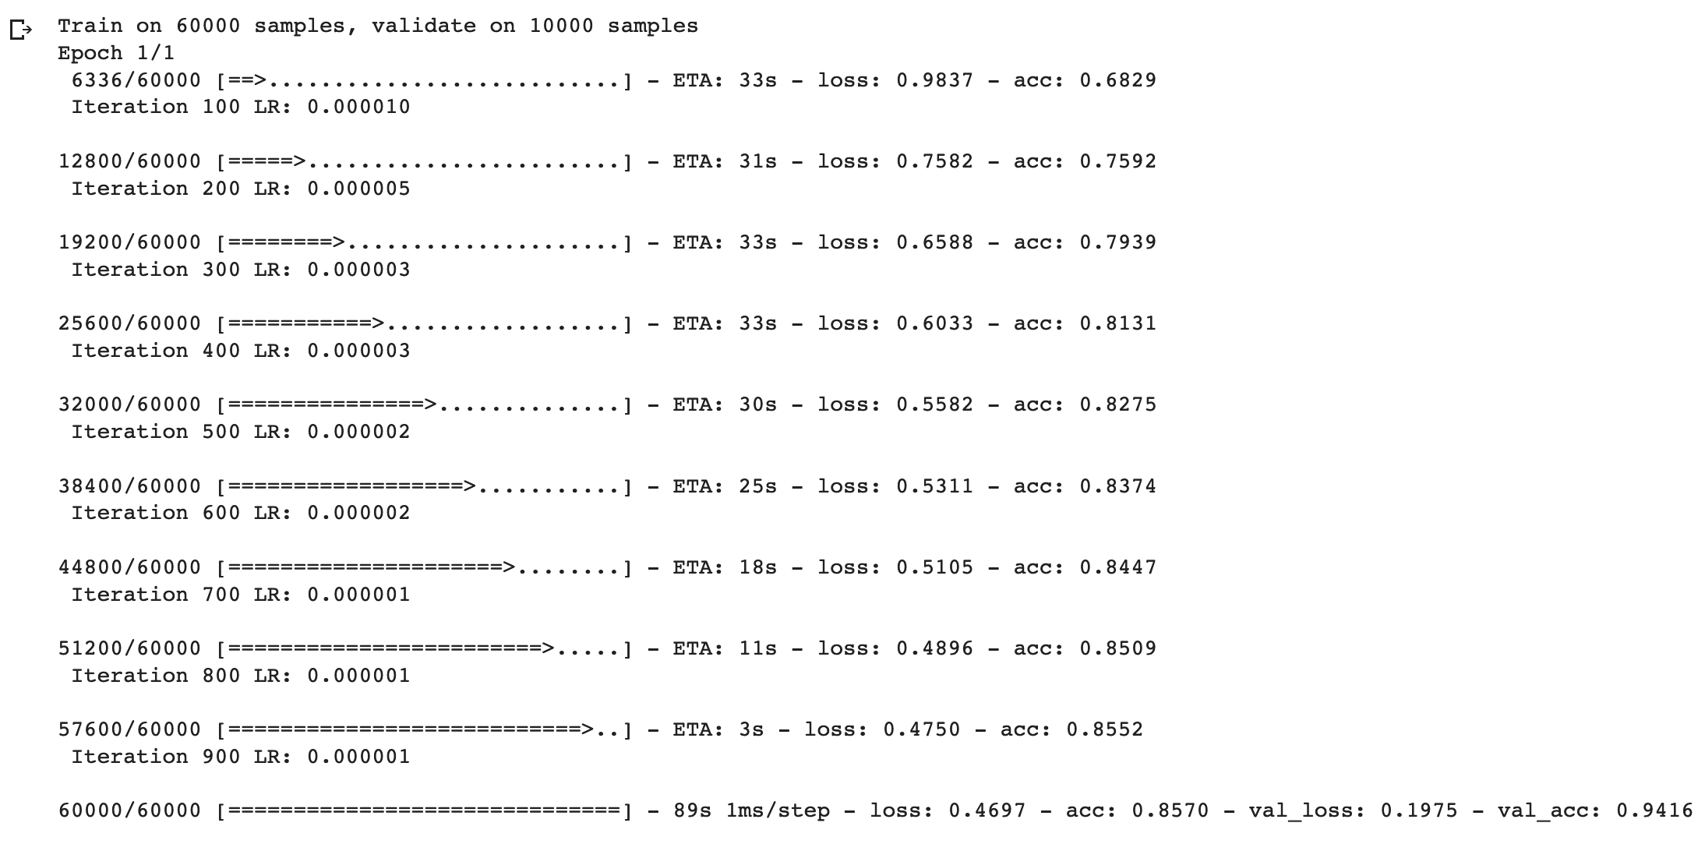

Slide 45
Problem of overfitting
Regularization
L2
Dropout
Data augmentation
Early stopping
akshaybahadur.com
Notes:
L2 reg - L2-regularization relies on the assumption that a model with small weights is simpler than a model with large weights. Thus, by penalizing the square values of the weights in the cost function you drive all the weights to smaller values. It becomes too costly for the cost to have large weights! This leads to a smoother model in which the output changes more slowly as the input changes.

Slide 46
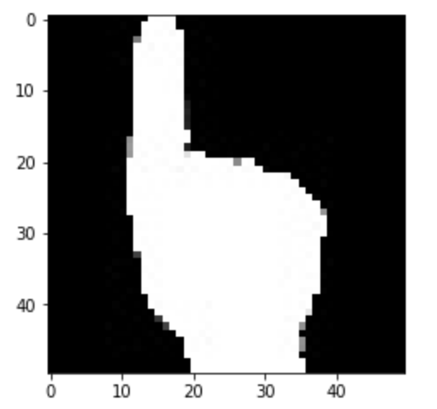
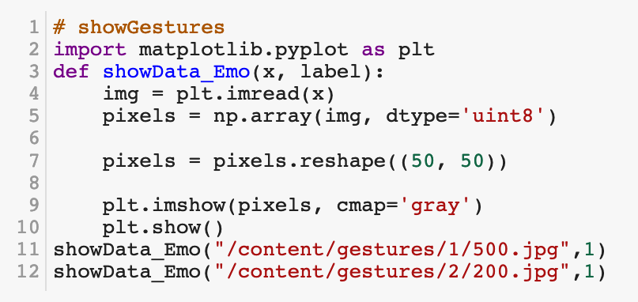
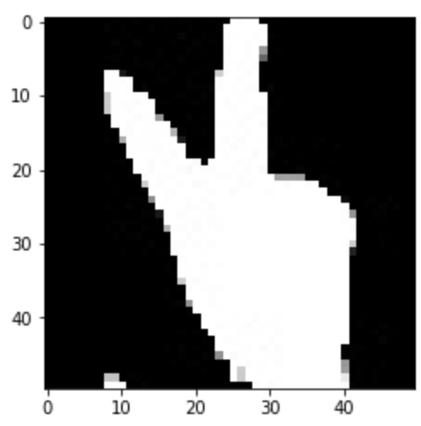
Data Augmentation

Slide 47
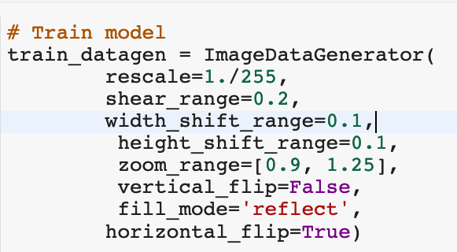
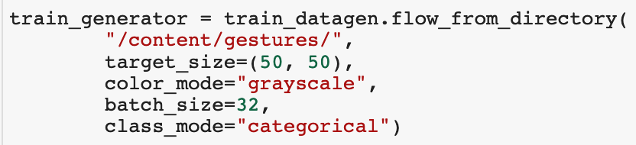
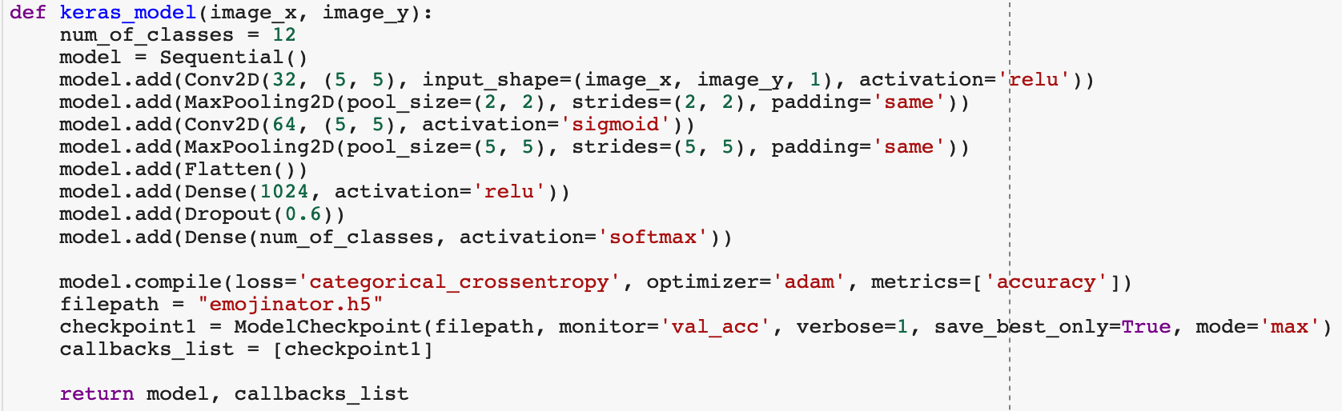
akshaybahadur.com

Slide 48
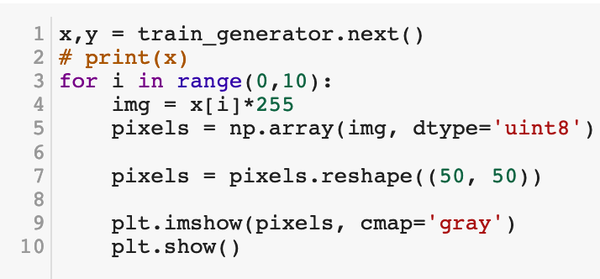
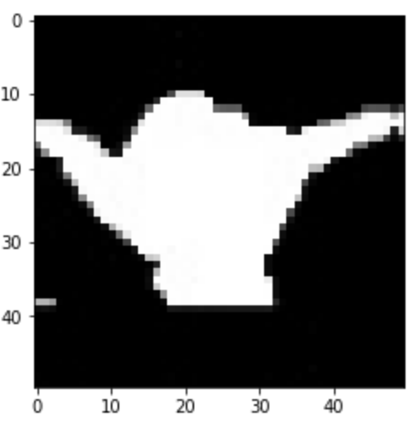
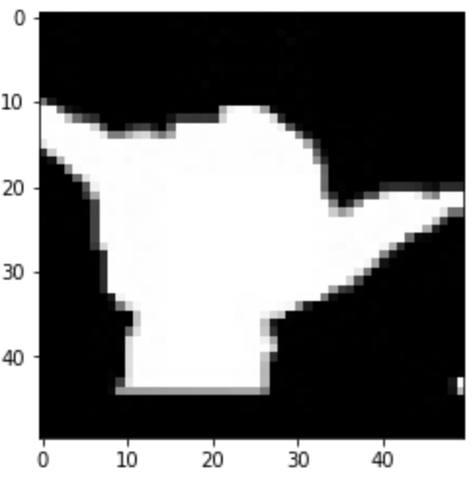
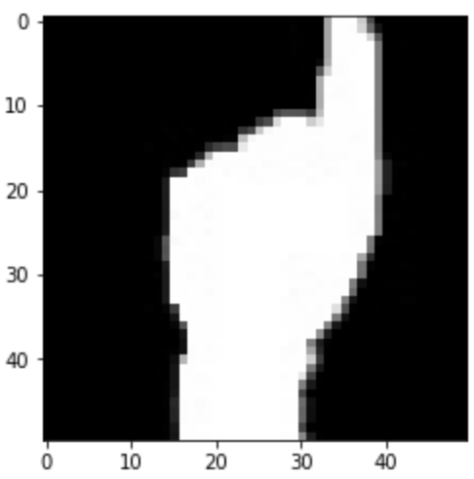





akshaybahadur.com

Slide 49




Slide 50
Hyperparameters Tuning
Learning rate.
Mini-batch size.
No. of hidden units.
No. of layers.
Learning rate decay.
Regularization lambda.
Activation functions.
Resource Utilization
akshaybahadur.com

Slide 51

DeepSign

Slide 52

akshaybahadur.com

Slide 53

akshaybahadur.com

Slide 54

See you next time
Content : http://bit.ly/dsc-ttt
Find me here: akshaybahadur.com
Thank you very much :)
akshaybahadur.com

